Slide 1





Course Name object oriented analysis and design
CSC 2210
(Undergraduate)
Software engineering (Undergraduate)
Chapter 2 use case diagram
Victor Stany Rozario
Assistant Professor,
Department of Computer Science, AIUB
Web: https://cs.aiub.edu/profile/stany

Slide 2
Usage of Use case diagram?
Chapter 2: Use Case Diagram
Victor Stany Rozario
S.2
Use case diagrams are used to visualize, specify, construct, and document the (intended) behavior of the system, during requirements capture and analysis.
Provide a way for developers, domain experts, and end-users to Communicate.
Serve as basis for testing.
Use case diagrams contain use cases, actors, and their relationships.

Slide 3

USE Case
Chapter 2: Use Case Diagram
Victor Stany Rozario
S.3
Use cases specify desired behavior.
A use case is a description of a set of sequences of actions, including variants (alternatives), a system performs to yield an observable result of value to an actor.
The names of use cases are always written in the form of a verb followed by an object.
Each sequence represent an interaction of actors with the system.
Describing the flow of events within the use case.
Can be done in natural language, formal language or pseudo-code.
Includes:
How and when the use case starts and ends;
When the use case interacts with actors and what objects are exchanged;
The basic flow and alternative flows of the behavior.

Slide 4
actor
Chapter 2: Use Case Diagram
Victor Stany Rozario
S.4
An actor represents a set of roles that users of use case play when interacting with these use cases.
Actors can be human or automated systems.
Actors are entities
which require help from the system to perform their task, or
are needed to execute the system’s functions.
Actors are not part of the system.
A system can be an Actor of other systems
Actor

Slide 5
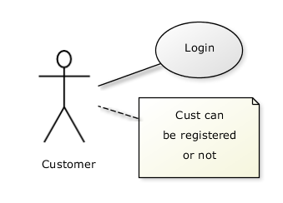
Use cases and actor
Chapter 2: Use Case Diagram
Victor Stany Rozario
S.5
From the perspective of a given actor, a use case does something that is of value to the actor, such as calculate a result or change the state of an object.
The Actors define the environments in which the system lives
Actors may be connected to use cases by associations, indicating that the actor and the use case communicate with one another using messages.
updating
grades
faculty

Slide 6
Example of Use cases diagram
Chapter 2: Use Case Diagram
Victor Stany Rozario
S.6
University Management System
Login
Registration of Course
Faculty
Student
Upload Grade

Slide 7
Relationships between Use cases
Chapter 2: Use Case Diagram
Victor Stany Rozario
S.7
Include - use cases that are included as parts of other use. Enable to factor common behavior
The base use case explicitly incorporates the behavior of another use case at a location specified in the base.
The included use case never stands alone. It only occurs as a part of some larger base that includes it. The original use case is not complete without the included one
base
<<include>>
included

Slide 8
Relationships between Use cases
Chapter 2: Use Case Diagram
Victor Stany Rozario
S.8
Enables to avoid describing the same flow of events several times by putting the common behavior in a use case of its own.
updating
grades
<<include>>
verifying
Id and password
<<include>>
registration

Slide 9
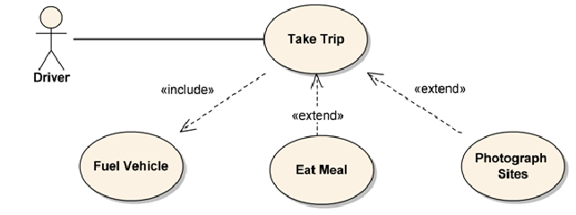
Relationships between Use cases
Chapter 2: Use Case Diagram
Victor Stany Rozario
S.9
Extend – a part of a use case that is optional system behavior
The base use case implicitly incorporates the behavior of another use case at certain points called extension points.
The base use case may stand alone, but under certain conditions its behavior may be extended by the behavior of another use case.
Enables to model optional behavior or branching under conditions.
Vacation
<<extend>>
base
extending

Slide 10
Relationships between Use cases
Chapter 2: Use Case Diagram
Victor Stany Rozario
S.10
Generalization - A generalization relationship means that a child use case inherits the behavior and meaning of the parent use case. The child may add or override the behavior of the parent.
Student registration
under-graduate
registration
graduate
registration

Slide 11
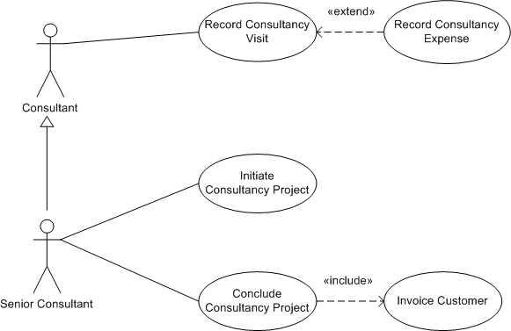
Relationships between ACTORS
Chapter 2: Use Case Diagram
Victor Stany Rozario
S.11
Generalization - A generalization relationship means that a child actor inherits the behavior and meaning of the parent actor. The child may add or override the behavior of the parent.

Slide 12
Use cases description
Chapter 2: Use Case Diagram
Victor Stany Rozario
S.12
Title or Reference Name - meaningful name of the UC
Author/Date - the author and creation date
Modification/Date - last modification and its date
Purpose - specifies the goal to be achieved
Overview - short description of the processes
Cross References - requirements references
Actors - agents participating
Pre-Conditions - must be true to allow execution
Post Conditions - will be set when completes normally
Normal flow of events - regular flow of activities
Alternative flow of events - other flow of activities
Exceptional flow of events - unusual situations
Implementation issues - foreseen implementation problems

Slide 13
Use cases example – atm money withdraw
Chapter 2: Use Case Diagram
Victor Stany Rozario
S.13
Use case Title: UC-1
Use Case: Withdraw Money
Author: Jack Lonagon
Created Date: 1-OCT-2015
Modification Date: 20-Apr-2017
Purpose: To withdraw some cash from user’s bank account
Overview: The use case starts when the customer inserts his credit card into the system. The system requests the user PIN. The system validates the PIN. If the validation succeeded, the customer can choose the withdraw operation else alternative 1 – validation failure is executed. The customer enters the amount of cash to withdraw. The system checks the amount of cash in the user account, its credit limit. If the withdraw amount in the range between the current amount + credit limit, the system dispense the cash and prints a withdraw receipt, else alternative 2 – amount exceeded is executed.
Cross References: UC-3

Slide 14
Use cases example – atm money withdraw
Chapter 2: Use Case Diagram
Victor Stany Rozario
S.14
Actors: Customer
Pre-Condition:
The ATM must be in a state ready to accept transactions
The ATM must have at least some cash on hand that it can dispense
The ATM must have enough paper to print a receipt for at least one transaction
Post Condition:
The current amount of cash in the user account is the amount before the withdraw minus the withdraw amount
A receipt was printed on the withdraw amount
The withdraw transaction was audit in the System log file

Slide 15
Use cases example – atm money withdraw
Chapter 2: Use Case Diagram
Victor Stany Rozario
S.15
Typical Course of events:
Actor Actions | System Actions
1. Begins when a Customer arrives at ATM
2. Customer inserts a Credit card into ATM & PIN | 3. System verifies the customer ID and PIN
5. Customer chooses “Withdraw” operation | 4. System asks for an operation type
7. Customer enters the cash amount | 6. System asks for the withdraw amount
 | 8. System checks if withdraw amount is legal (50k per day)
 | 9. System dispenses the cash
 | 10. System deduces the withdraw amount from account balance and set new balance
 | 11. System prints a receipt
13. Customer takes the cash and the receipt | 12. System ejects the cash card

Slide 16
Use cases example – atm money withdraw
Chapter 2: Use Case Diagram
Victor Stany Rozario
S.16
Alternative flow of events:
Step 3: Customer authorization failed. Display an error message, cancel the transaction and eject the card. Some other thing may happen for example go to step 2 try login again for maximum 3 times and after that the failed login attempt will seize and inform related authority of any suspicious activity in the ATM machine.
Step 8: Customer has insufficient funds in its account. Display an error message and go to step 6.
Step 8: Customer exceeds its legal amount. Display an error message and go to step 4.
Exceptional flow of events:
Power failure in the process of the transaction before step 9, cancel the transaction and eject the card

Slide 17
Identify Use cases
Chapter 2: Use Case Diagram
Victor Stany Rozario
S.17
One method to identify use cases is actor-based:
- Identify the actors related to a system or organization.
For each actor, identify the processes they initiate or participate in.
A second method to identify use cases is event-based:
- Identify the external events that a system must respond to.
- Relate the events (cash withdraw) to actors (customer) and use cases (ATM system).
The following questions may be used to help identify the use cases for a system:
What are the tasks of each actor ?
Will any actor create, store, change, remove, or read information in the system ?
What use cases will create, store, change, remove, or read this information ?
Will any actor need to inform the system about sudden, external changes ?
Does any actor need to be informed about certain occurrences in the system ?

Slide 18
Case Studies: Use Case Diagram
Chapter 2: Use Case Diagram
Victor Stany Rozario
S.18
Case 1:
In a hotel management system, a guest can rent rooms. Hotel receptionist uses the system to assist in the renting. A guest can also book a room for future renting with the help of the receptionist, but he has to check if the room has prior booking or not. A Guest pays for the rooms at the time they check out. He can pay by cash, cheque or credit card. Receptionists has to logon to the system before they can use it, but to logon he has go through username/password verification.

Slide 19
Case Studies: Use Case Diagram
Chapter 2: Use Case Diagram
Victor Stany Rozario
S.19
Case 2:
Music Today is an audio recording company. There are several recordists in the company. Clients record their music with the help of the recordists. The recording is done in a session. A session is usually created by the office clerk. A session needs to be booked by the client beforehand and before booking the time needs to be verified by the booking clerk for availability. The company maintains a list of preferred clients who book sessions like regular clients but also can create sessions according to their needs. Clerks have to log in to use the system. Clients can pay in cash or card. The accountant deals with the payment. The payment is only cleared when the accountant receives clearance from the booking clerk.

Slide 20
Case Studies: Use Case Diagram
Chapter 2: Use Case Diagram
Victor Stany Rozario
S.20
Case 3:
In a hospital management system, a patient's medical history is created by a doctor. A patient may be referred by a doctor to be admitted in the hospital. A patient can rent hospital facilities. An administrative officer deals with the renting. The system automatically checks whether the patient is referred by a doctor before he can rent any hospital facility. The types of facilities are rooms, beds or ICUs. Admitted patients are regularly visited by doctors and a nurse updates patient medical history after each visit. A doctor writes the discharge note of the patient when he leaves which is also included in the patient's medical history. An account clerk prepares the bill. The bill is calculated from the elements written in the medical history, i.e. number of doctor's visit, prescribed medication, tests. When the nurse updates the medical history she writes either the date-time of doctor's visit or prescribed medication or test. The patient may pay by cash or card when the bill is prepared.

Slide 21
Case Studies: Use Case Diagram
Chapter 2: Use Case Diagram
Victor Stany Rozario
S.21
Case 4:
ABCD Records is a mail order company that distributes CDs and tapes at discount prices to record club members. A member fills up an order form and sends it to the order processing clerk. When the order processing clerk receives an order form, she verifies that the sender is a club member by checking the member file. She also checks the status of the member whether he is a royal class member or regular class member. If the sender is not a member, the clerk returns the order along with a membership application form. If the customer is a member, the clerk verifies the order item data by checking the item file. Then the clerk enters the order data and saves it to the daily records file. At the same time the clerk also prints an invoice and shipping list for each order, which are forwarded to the collection department clerk for processing there. If the items are not available they are ordered if the member is a royal class member. Royal class members also get discounts. The members can pay by cash, check or bank draft.

Slide 22
references
Chapter 2: Use Case Diagram
Victor Stany Rozario
S.22
Booch, G., Rumbaugh, J. & Jacobson, I. (2005). The unified modeling language user guide. Pearson Education India.

